Slide 1
Azure DevOps
PIPELINE DECORATORS
Louis-Guillaume MORAND

Slide 2
Agenda
01
02
03
04
Introduction
Prerequisites
Architecture
REX

Slide 3
Extensibility

Slide 4
Azure DevOps can be extended with
Pipeline tasks: packaged build/releases tasks for the pipelines
Dashboard widgets: a chart or a fully customized widgets for the reporting dashboards
Work Item Form: customizing the types and the forms of the different WIT
A custom Hub: adding a custom left menu and extension space
Web extensions: adding screens and features to the platform
Pipeline decorators: dynamically injectable pipeline tasks

Slide 5
Recommended architecture

Slide 6
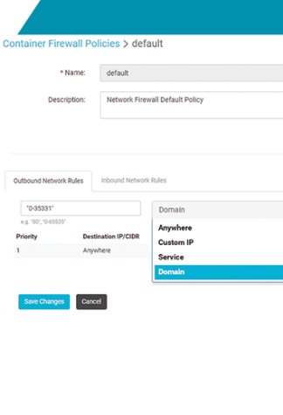
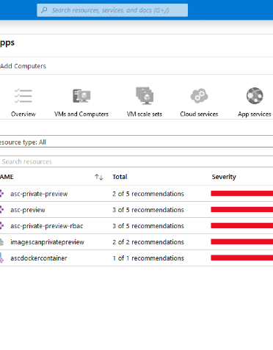




Security
Without full monitoring, the platform is a blackbox and unmanageable. It’s important to get metrics as much as logs in a unique and central repository,
Container scanning with Security Center or 3rd Party Software (Harbor, Aquasec, Qualys, etc.)
Runtime scanning of running pods with Aquasec
Containers network policies with Aquasec
Leverage Threat analytics (Security Center)
Notes:
By Louis-Guillaume MORAND – lomorand@microsoft.com

Slide 7






Internals
To properly fit in a micro-service architecture, each service should implement and take benefit of some relevant design patterns and good practices
CQRS
DDD & Domain events
Saga pattern
Api Composition
Usage of proven framework like .Net Core for easy depency injection.
Usage of framework to unify architecture accross all components (i.e. Dapr)
Notes:
By Louis-Guillaume MORAND – lomorand@microsoft.com

Slide 8
Future of microservices
Notes:
By Louis-Guillaume MORAND – lomorand@microsoft.com

Slide 9
Application focused
Describes application components and operations as first-class concepts without having to stitch together individual container primitives
Flexible application modeling supports a wide range of application architectures
Small and simple applications are easy, large and complex applications are manageable
Open Application Model
Container infrastructure
Service
Deployment
Service
Endpoint
ingress
autoscale
ReplicaSet
Namespace
ConfigMap
Task
Worker
Pod
Secret
VolumeAttach
cron
canary
Job
Volume
CronJob
Notes:
By Louis-Guillaume MORAND – lomorand@microsoft.com

Slide 10
Return of experience
Notes:
By Louis-Guillaume MORAND – lomorand@microsoft.com

Slide 11
Main
Mistakes
All Microservices Should Be Written in the Same Programming Language
Microservices, As the Name Implies, Should Be Small
Not Centralizing The Logging
Not Automating the Versioning and Releasing Process
Wrong service boundaries
One hop rule
Notes:
By Louis-Guillaume MORAND – lomorand@microsoft.com

Slide 12
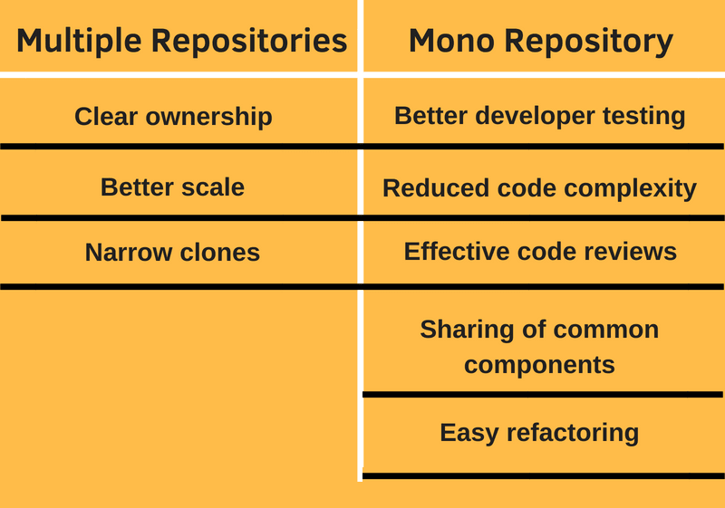
Mono or multi-repositories?
Notes:
By Louis-Guillaume MORAND – lomorand@microsoft.com

Slide 13
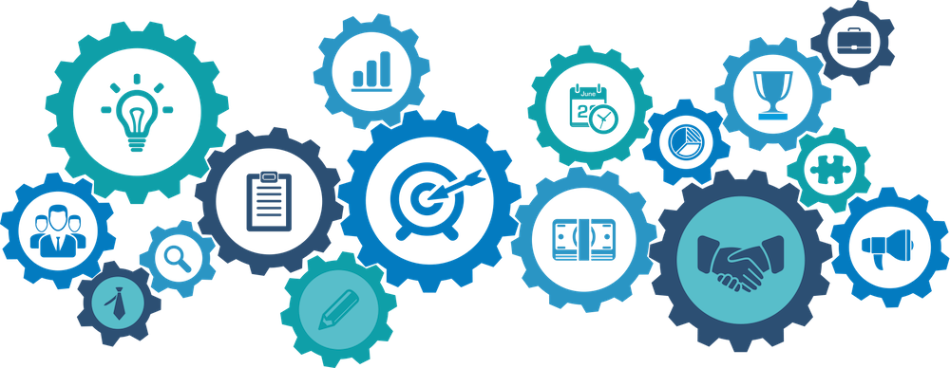
Thank You
Notes:
By Louis-Guillaume MORAND – lomorand@microsoft.com

